Slide 1
noLimit (Team-2)
Monique Shotande
Michael Dennis
Ricardo Joseph
Delano Igbinoba
Jordan Mason

Slide 2
Motivation & Overview
Why NoLimit?
Assist individuals with disabilities
Encourage individuals volunteer

Slide 3
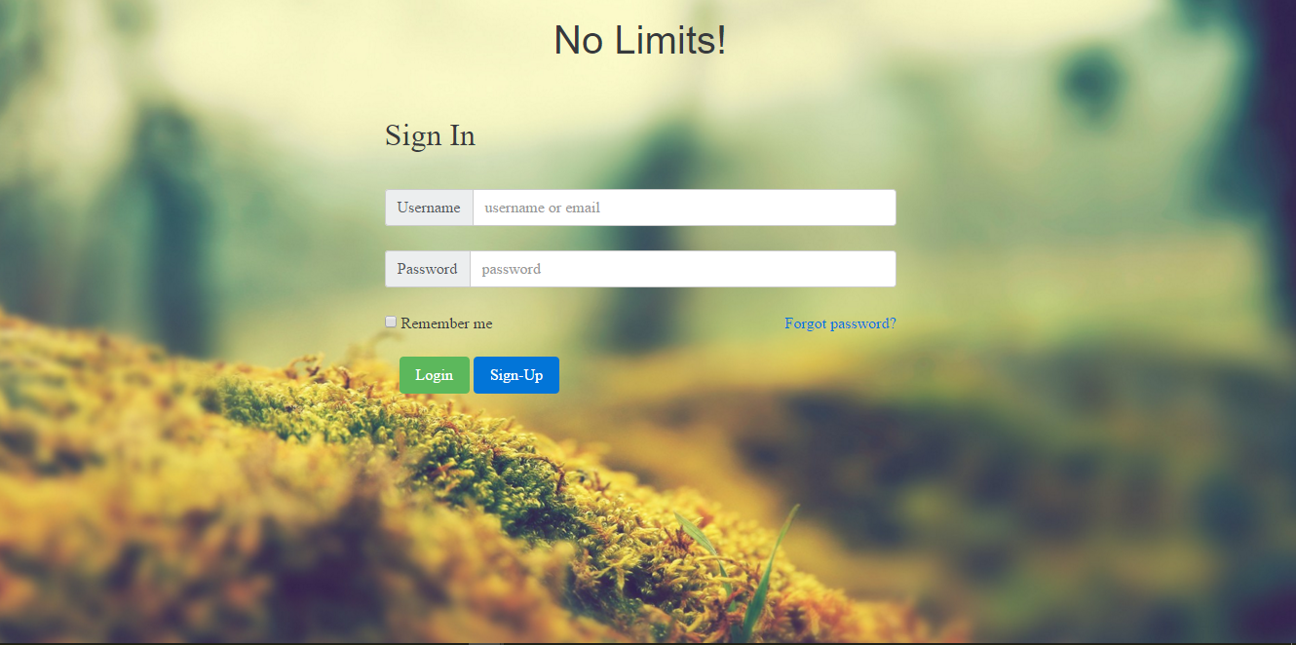
Features

Slide 4
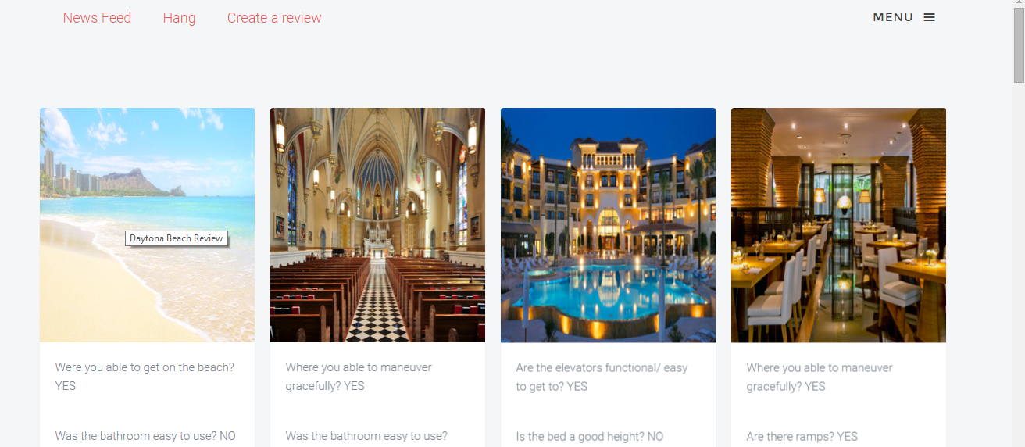
Features

Slide 5
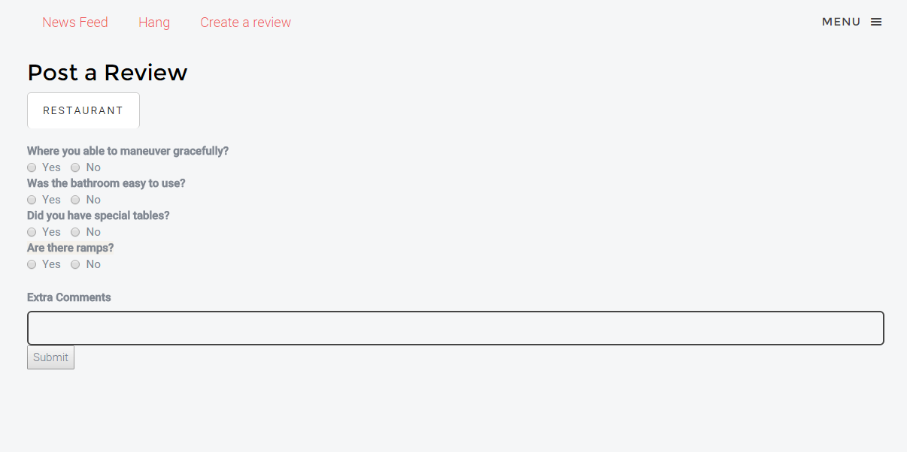
Features

Slide 6
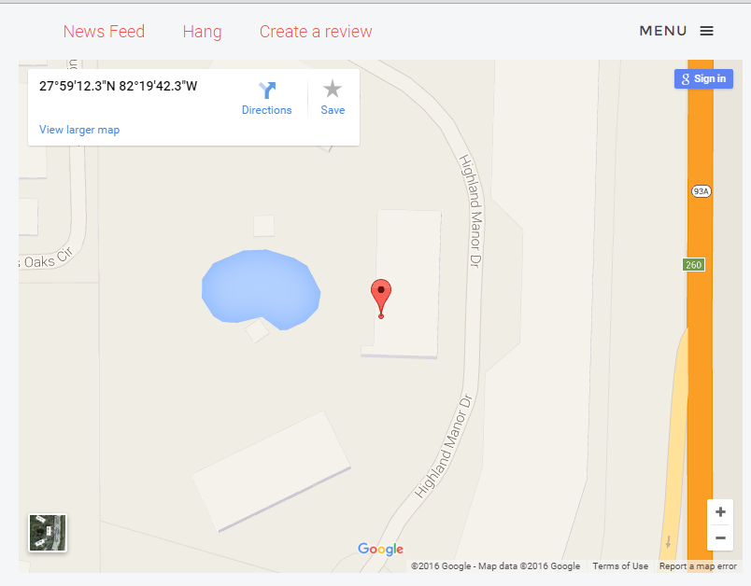
Features

Slide 7
Limitations & Challenges
Compatibility Issues
MeteorJs + Bootstrap
Location, Location, Location

Slide 8
Future Plans
Extended to Android and iOS
More secure database
Sponsorship
Extend Hangout Feature

Slide 9
Questions?

